Slide 1
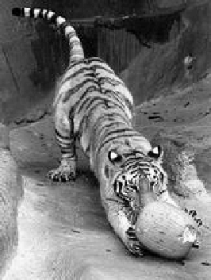
Images as graphs
i
w_{ij}
c
j
Fully-connected graph
  node for every pixel
  link between every pair of pixels, p,q
  similarity w_{ij} for each link
Source: Seitz

Slide 2
Segmentation by Graph Cuts
w
A
B
C
Break Graph into Segments
  Delete links that cross between segments
  Easiest to break links that have low cost (low similarity)
    similar pixels should be in the same segments
    dissimilar pixels should be in different segments
Source: Seitz

Slide 3
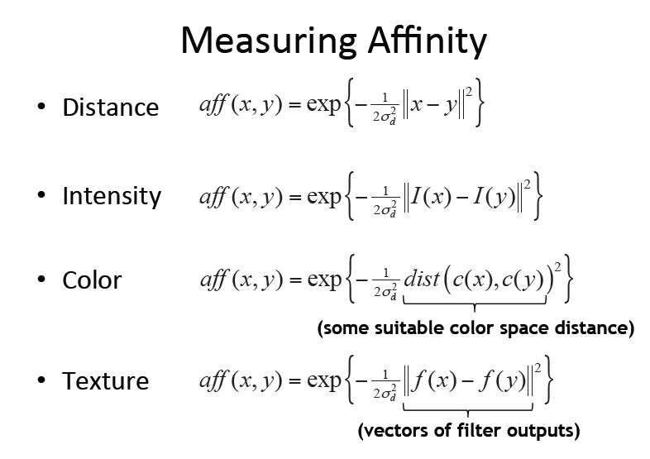

Slide 4
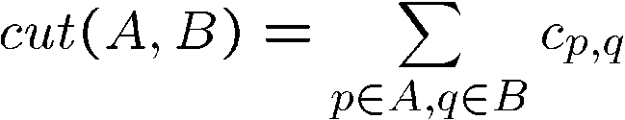
Cuts in a graph
B
A
Link Cut
  set of links whose removal makes a graph disconnected
  cost of a cut:
One idea: Find minimum cut
  gives you a segmentation
  fast algorithms exist for doing this
Source: Seitz

Slide 5
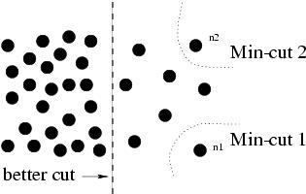
But min cut is not always the best cut...

Slide 6
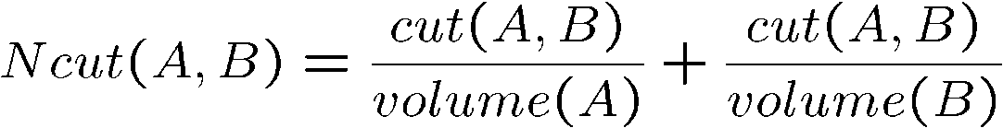
Cuts in a graph
B
A
Normalized Cut
  a cut penalizes large segments
  fix by normalizing for size of segments
  volume(A) = sum of costs of all edges that touch A
Source: Seitz

Slide 7
Finding Minimum Normalized-Cut
Finding the Minimum Normalized-Cut is NP-Hard.
Polynomial Approximations are generally used for segmentation
* Slide from Khurram Hassan-Shafique CAP5415 Computer Vision 2003

Slide 8
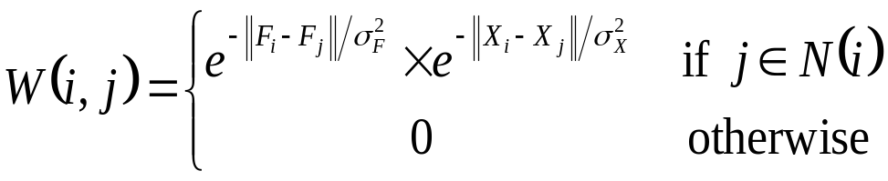
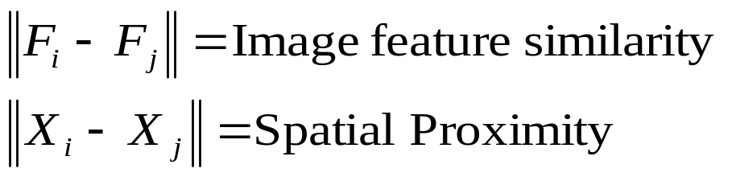
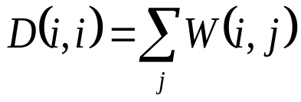
Finding Minimum Normalized-Cut
* From Khurram Hassan-Shafique CAP5415 Computer Vision 2003

Slide 9
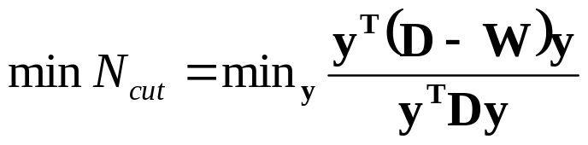

Finding Minimum Normalized-Cut
It can be shown that
such that
If y is allowed to take real values then the minimization can be done by solving the generalized eigenvalue system
* Slide from Khurram Hassan-Shafique CAP5415 Computer Vision 2003

Slide 10
Algorithm
Compute matrices W & D
Solve for eigen vectors with the smallest eigen values
Use the eigen vector with second smallest eigen value to bipartition the graph
Recursively partition the segmented parts if necessary.
* Slide from Khurram Hassan-Shafique CAP5415 Computer Vision 2003

Slide 11
Recursive normalized cuts
Given an image or image sequence, set up a weighted graph: G=(V, E)
  Vertex for each pixel
  Edge weight for nearby pairs of pixels
Solve for eigenvectors with the smallest eigenvalues: (D − W)y = λDy
  Use the eigenvector with the second smallest eigenvalue to bipartition the graph
  Note: this is an approximation
4. Recursively repartition the segmented parts if necessary
http://www.cs.berkeley.edu/~malik/papers/SM-ncut.pdf
Details:

Slide 12
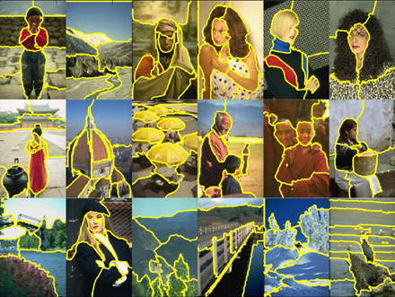
Normalized cuts results

Slide 13
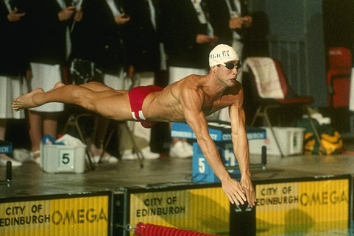
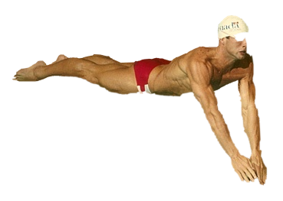
Graph cuts segmentation

Slide 14
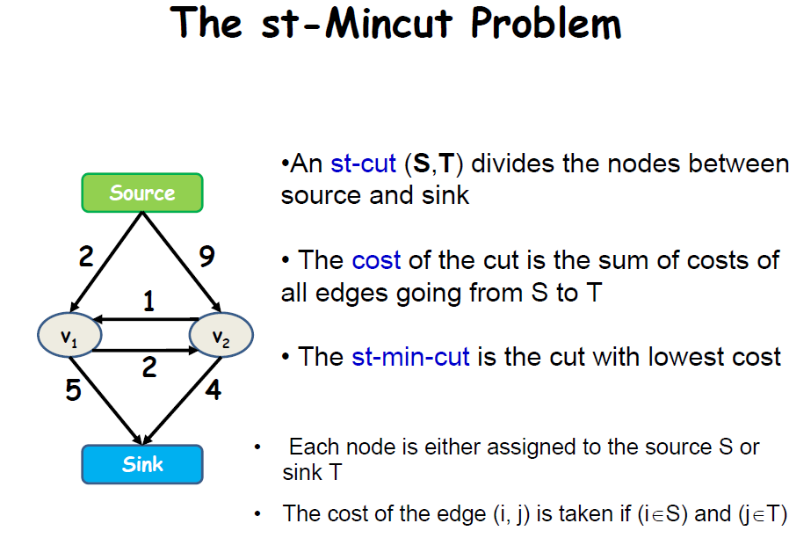

Slide 15
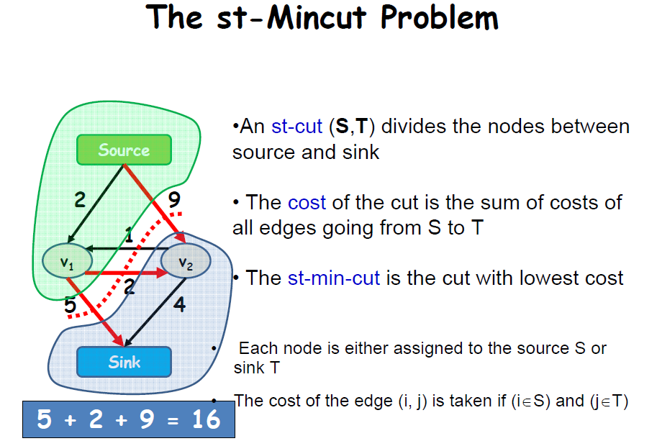

Slide 16
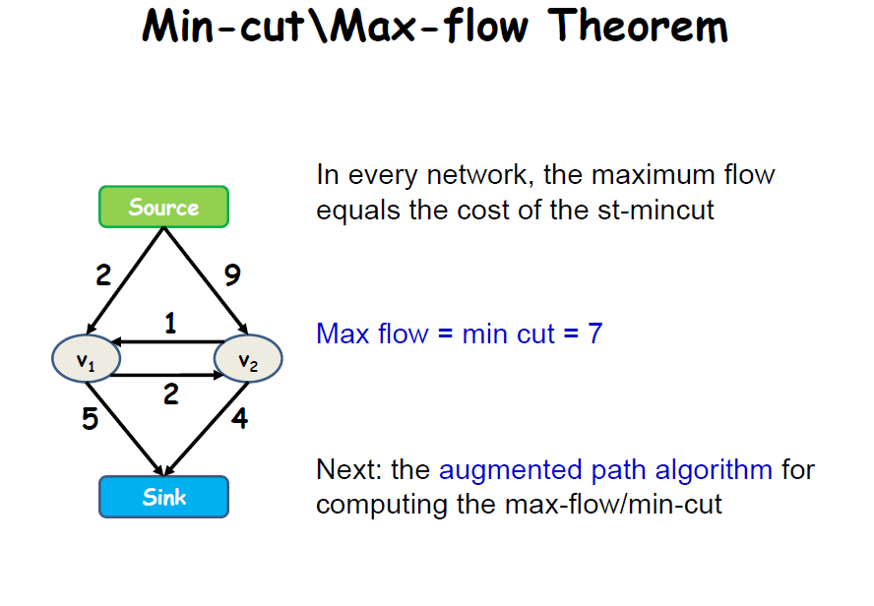

Slide 17
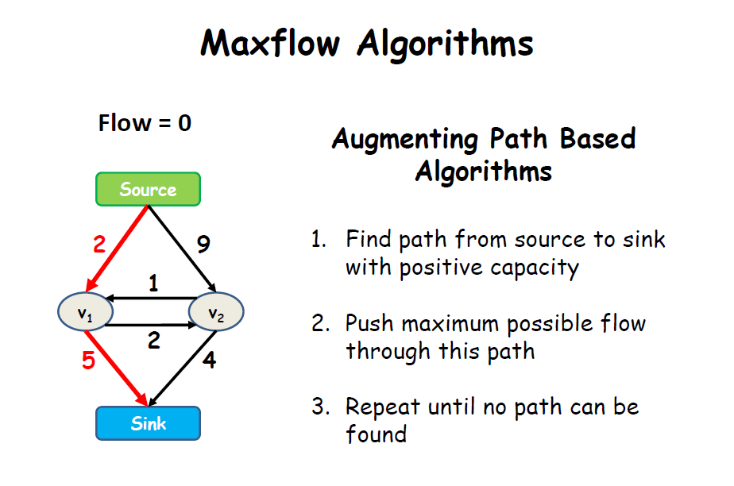

Slide 18
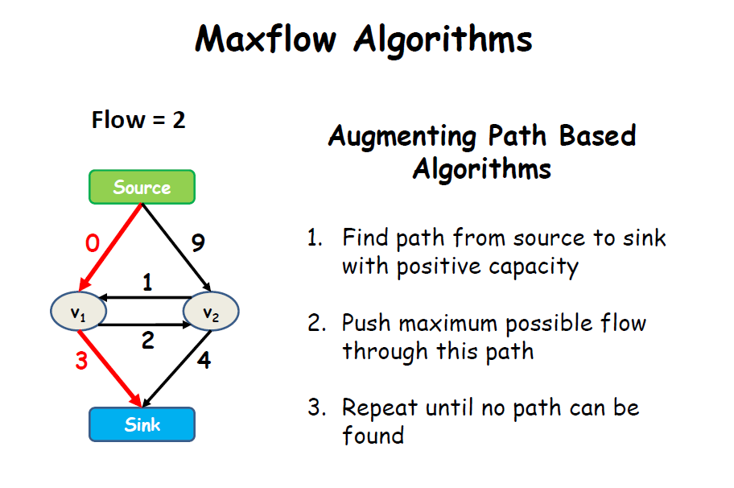

Slide 19
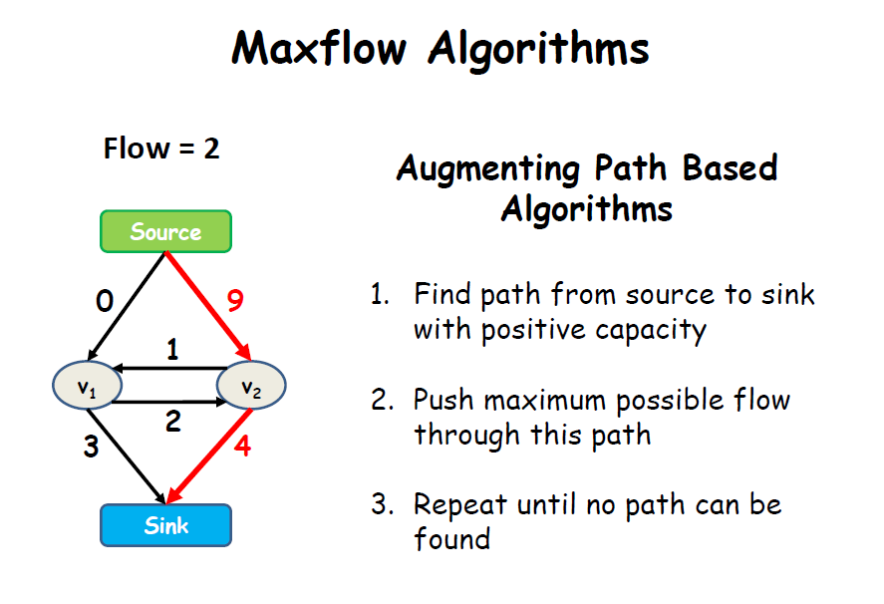

Slide 20
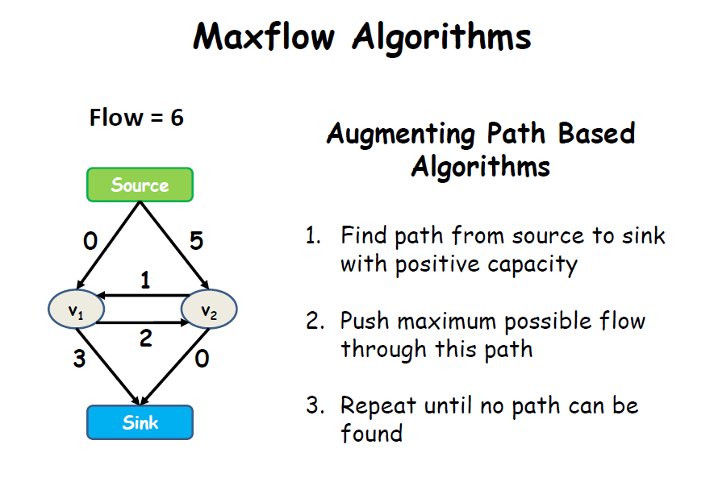

Slide 21
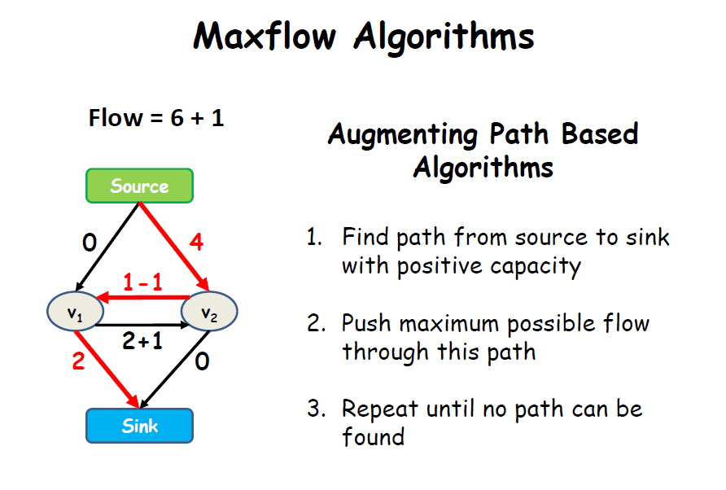

Slide 22
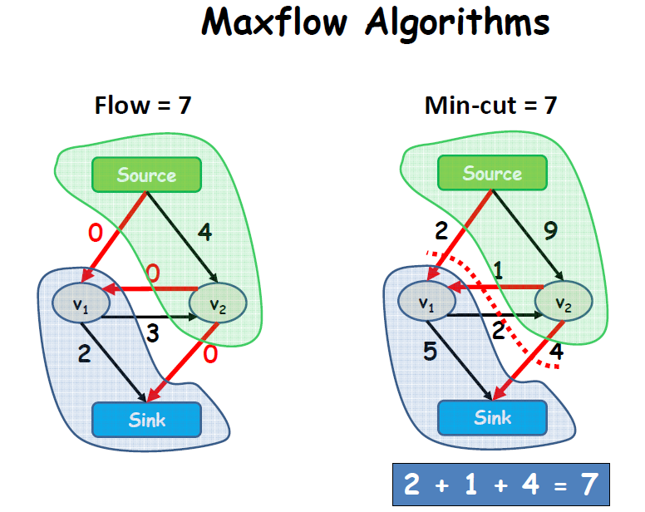

Slide 23
Markov Random Fields
Node y_{i}: pixel label
Edge: constrained pairs
Cost to assign a label to each pixel
Cost to assign a pair of labels to connected pixels

Slide 24
Markov Random Fields
Unary potential
Example: “label smoothing” grid
0: -logP(y_{i} = 0 ; data)
1: -logP(y_{i} = 1 ; data)
Pairwise Potential
0 1
0 0 K
1 K 0

Slide 25
Solving MRFs with graph cuts
Source (Label 0)
Cost to assign to 0
Cost to split nodes
Cost to assign to 1
Sink (Label 1)

Slide 26
Solving MRFs with graph cuts
Source (Label 0)
Cost to assign to 0
Cost to split nodes
Cost to assign to 1
Sink (Label 1)

Slide 27
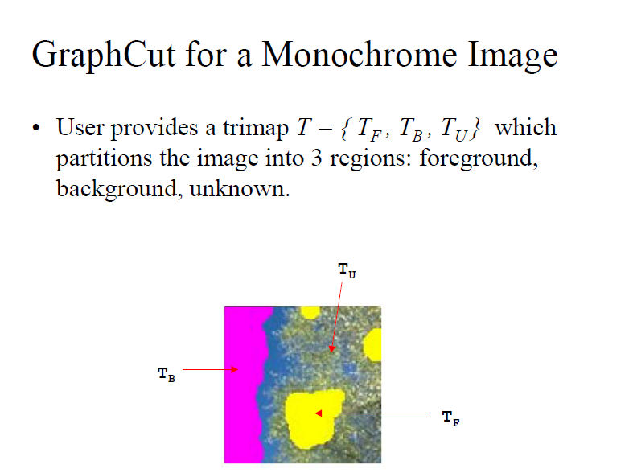

Slide 28
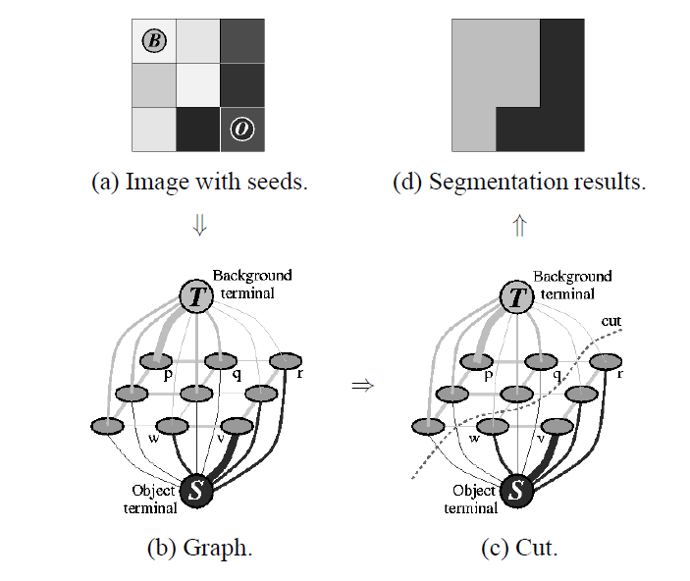

Slide 29

Graph cuts
Boykov and Jolly (2001)
Foreground (source)
Image
Min Cut
Background
(sink)
Cut: separating source and sink; Energy: collection of edges
Min Cut: Global minimal enegry in polynomial time
Source: Rother
Notes:
Optimization engine we use Graph Cuts. By now everybody should know what graph cut is. IN case you missed it here is a very brief introduction.
To image. 3D view. First task to construct a graph.
All pixels on a certain scanline. Just a few of them.
Next step introduce artificial nodes. fgd and background.
Edges – contrast. Boundary is quite likely between black and white.
Min Cut - Minimum edge strength.

Slide 30
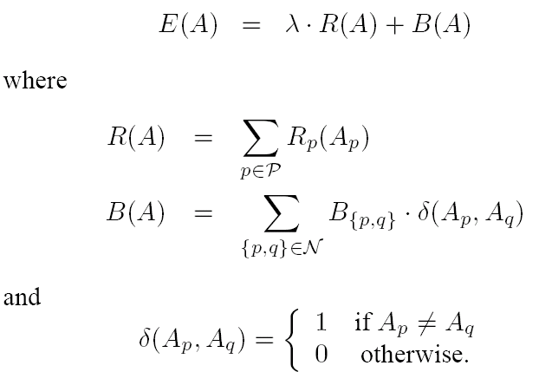
Optimization Formulation - Boykov & Jolly ‘01
A – Proposed Segmentation
E(A) – Overall Energy
R(A) – Degree to which pixels fits model
B(A) – Degree to which the cuts breaks up similar pixels
- Balance A() and B()
Goal: Find Segmentation, A, which minimizes E(A)
Notes:
R – Region Term
B – Boundary Term

Slide 31
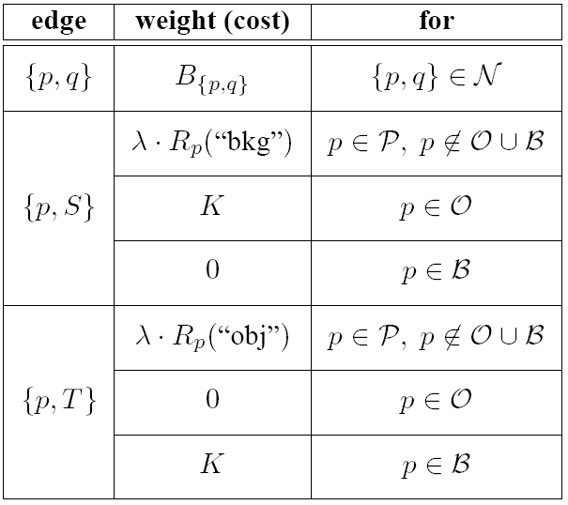

Link Weights
Pixel links based on color/intensity similarities
Source/Target links based on histogram models of fore/background
Notes:
Initial Strokes by

Slide 32
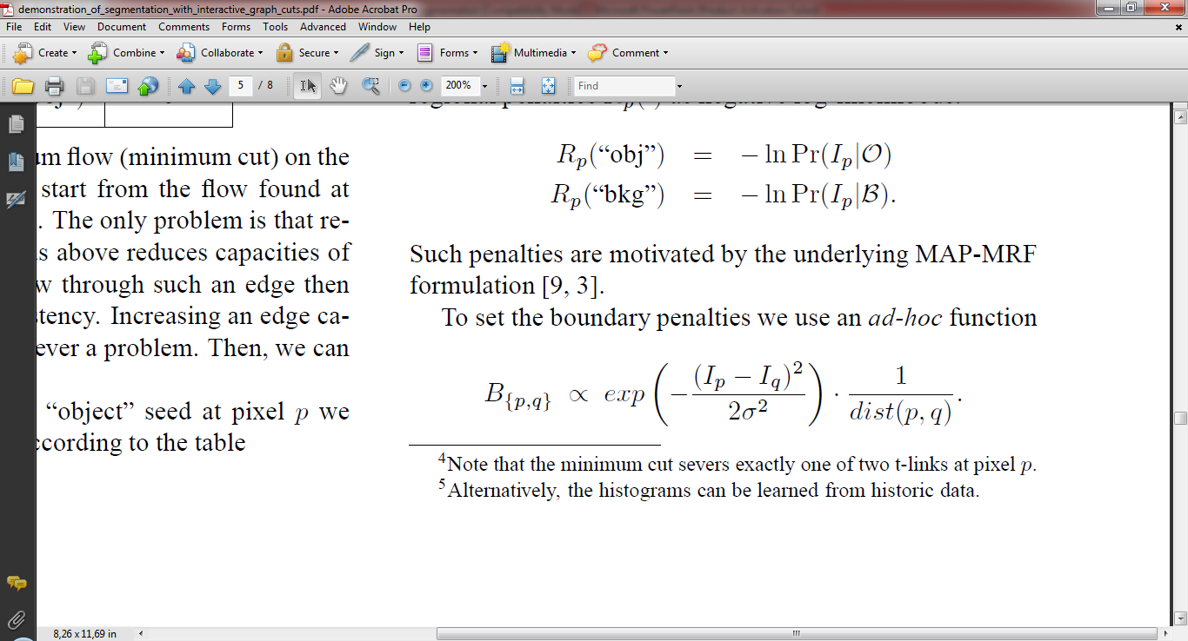

Slide 33
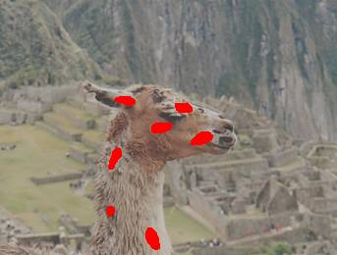
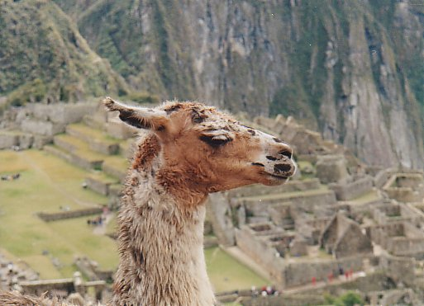
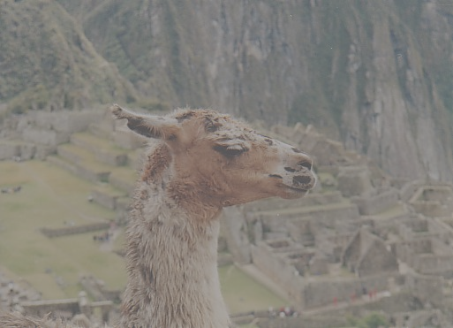
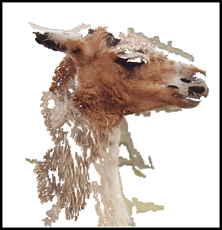
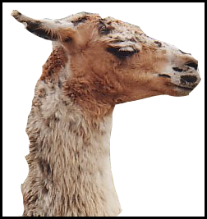
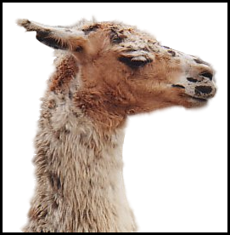
Grab cuts and graph cuts
Magic Wand
(198?)
Intelligent Scissors
Mortensen and Barrett (1995)
GrabCut
User
Input
Result
Regions
Boundary
Regions & Boundary
Source: Rother
Notes:
Basic idea is to combine the information which was used in the 2 well known tools: MW and IS.
MS select a region of similar colour according to your input. Fat pen and the boundary snapps to high contrast edges.
Grabcut combines it. And this allows us to simplify the user interface considerably by …

Slide 34
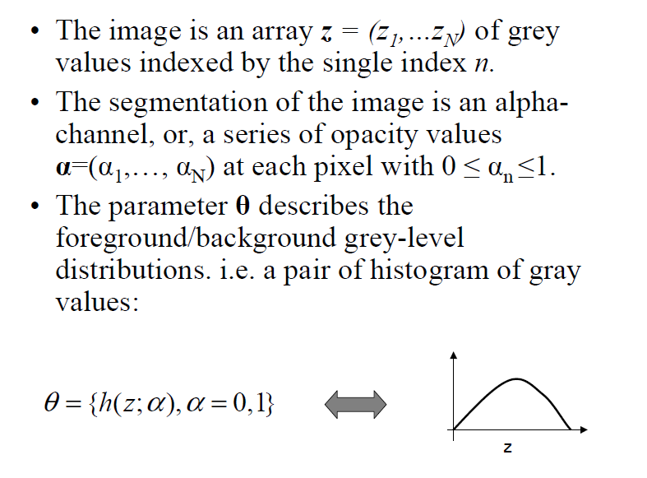

Slide 35
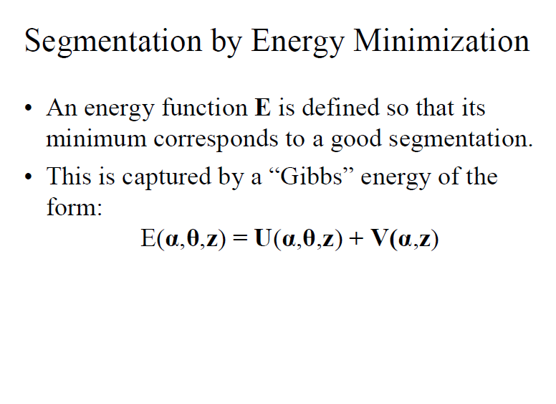

Slide 36
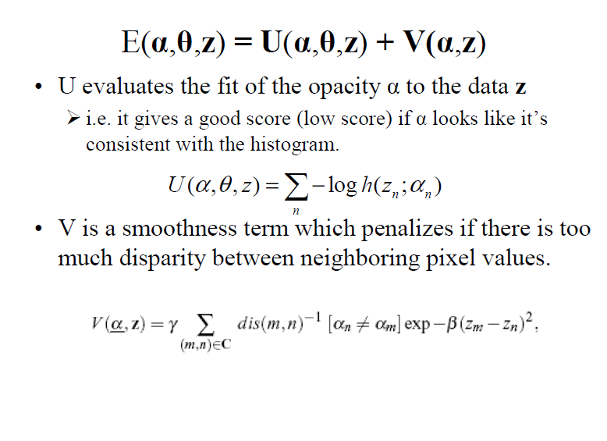
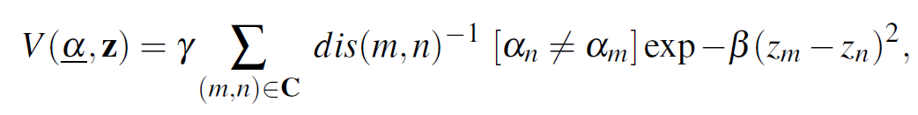
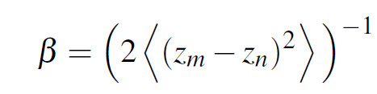

Slide 37
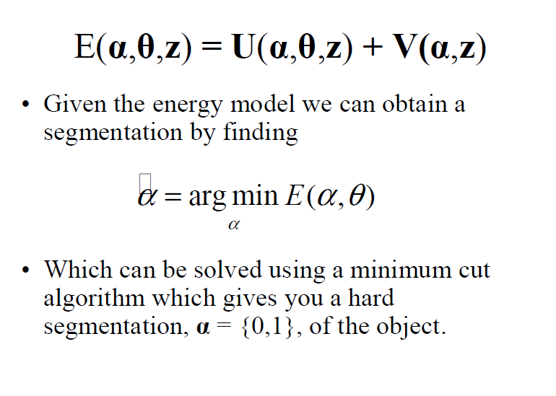

Slide 38
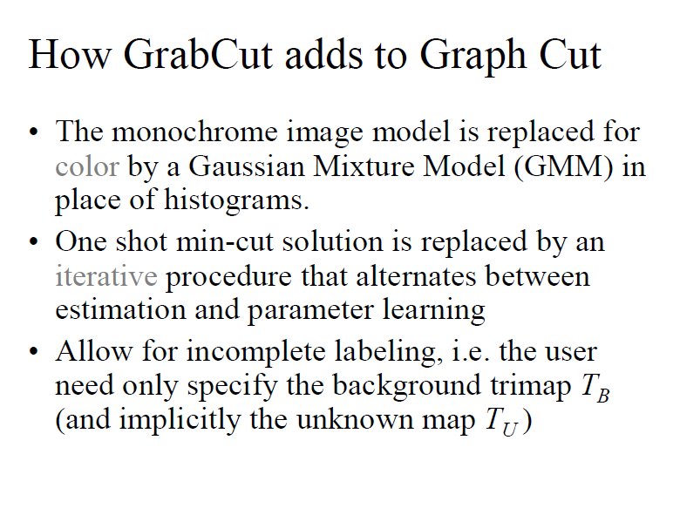

Slide 39
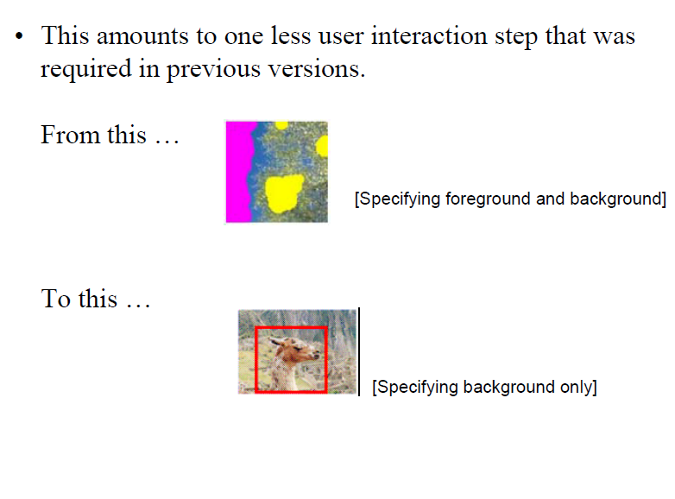

Slide 40
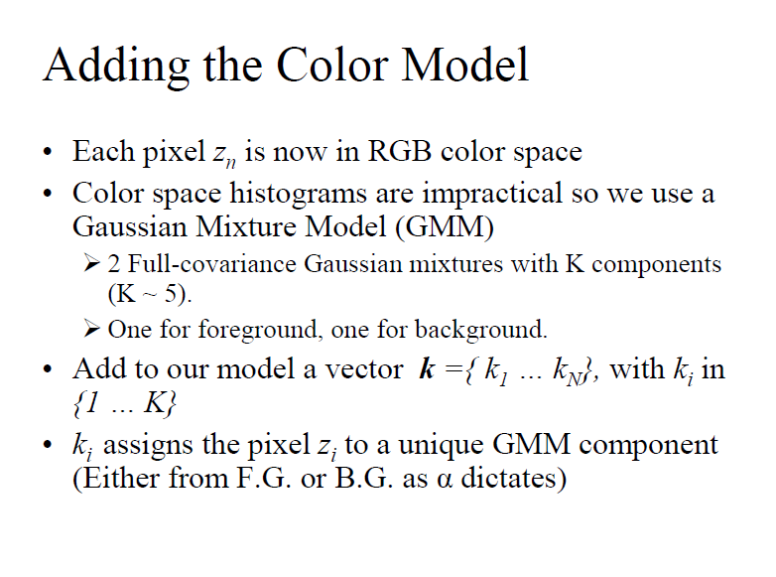

Slide 41
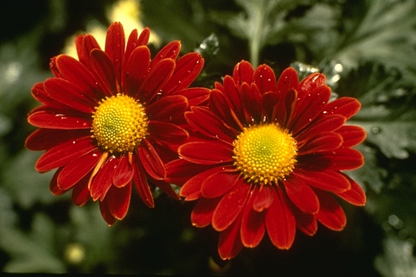

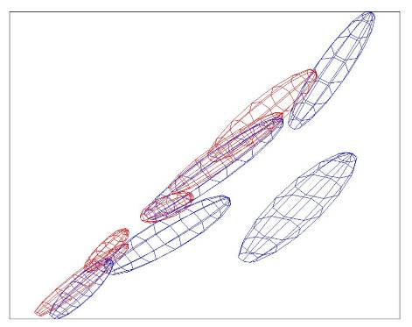
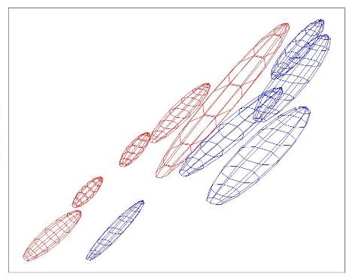

Colour Model
R
R
Foreground &
Background
Iterated graph cut
Foreground
Background
G
Background
G
Gaussian Mixture Model (typically 5-8 components)
Source: Rother
Notes:
Color enbergy.
Iterations have the effect of pulling them away;
D is – log likelyhood of the GMM.

Slide 42
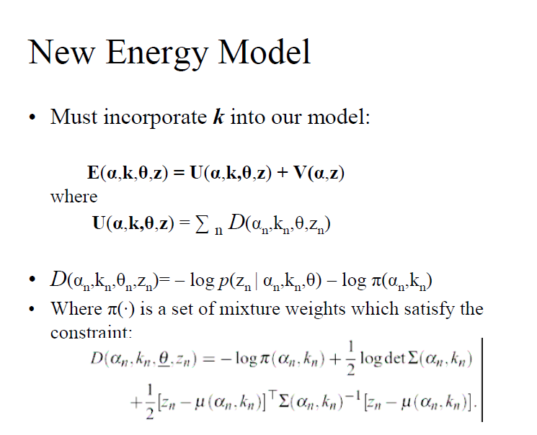
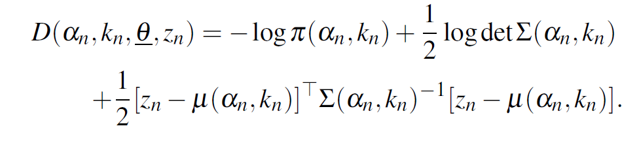

Slide 43
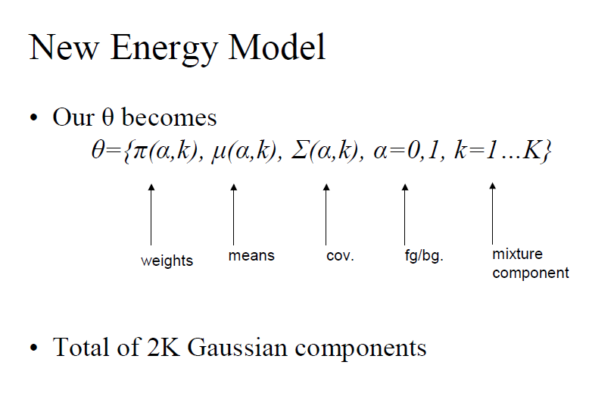

Slide 44
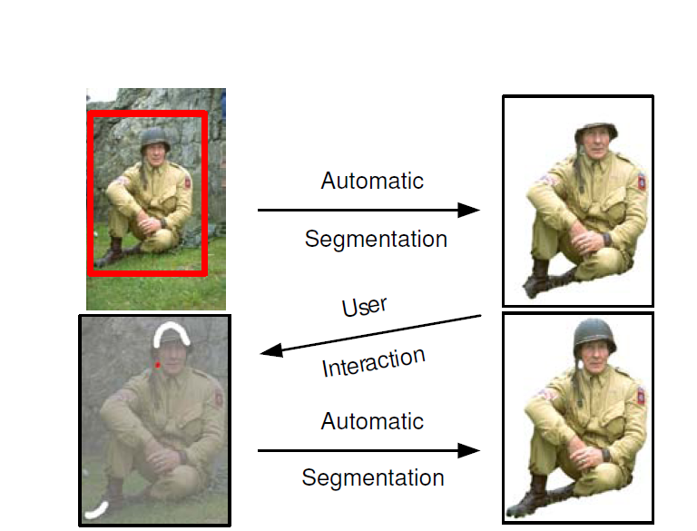

Slide 45
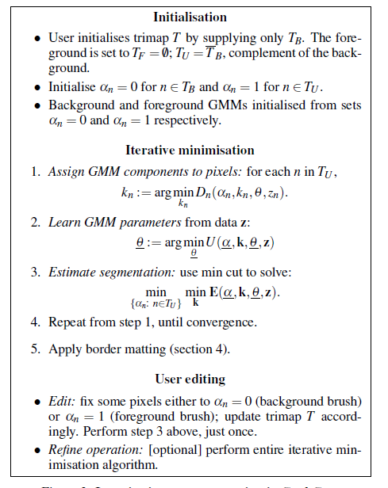
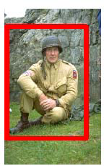

Slide 46







Moderately straightforward examples
… GrabCut completes automatically
GrabCut – Interactive Foreground Extraction 10
Notes:
Moderately straightforward examples- after the user input automnatically

Slide 47





Difficult Examples
Camouflage &
Low Contrast
Fine structure
Harder Case
Initial Rectangle
Initial
Result
GrabCut – Interactive Foreground Extraction 11
Notes:
You might wonder when does it fail. 4 cases. Low contrats – an edge not good visible

Slide 48







Border Matting
Hard Segmentation
Automatic Trimap
Soft Segmentation
to
GrabCut – Interactive Foreground Extraction 23
Notes:
So far hard segmentation.

Slide 49



Comparison
With no regularisation over alpha
Input
Bayes Matting
Chuang et. al. (2001)
Knockout 2
Photoshop Plug-In
Shum et. al. (2004): Coherence matting in “Pop-up light fields”
GrabCut – Interactive Foreground Extraction 24
Notes:
Problem – no regularisation over alpha.

Slide 50
Natural Image Matting
Mean Colour Foreground
Mean Colour
Background
Solve
Ruzon and Tomasi (2000): Alpha estimation in natural images
GrabCut – Interactive Foreground Extraction 25
Notes:
Given a pixel with a certain colour C, we have to solve the following eq. which
Has the true fgd, and bkg colour and the unknown propotion in terms of alpha.
Neighborhood – mean colour F, B. now eq. was under constr now overconstrained.

Slide 51


Slide 52



Border Matting
Foreground
Noisy alpha-profile
1
Mix
Back-ground
0
Foreground
Mix
Background
Fit a smooth alpha-profile with parameters
GrabCut – Interactive Foreground Extraction 26
Notes:
Fit a smooth profile – as in FEATHERING

Slide 53



Dynamic Programming
t+1
t
DP
Result using DP Border Matting
Noisy alpha-profile
Regularisation
GrabCut – Interactive Foreground Extraction 27
Notes:
Stripes – orthogonal to the boundary. Minimize energy which says: similar sigmja mu, add a noisy data term

Slide 54


GrabCut Border Matting - Colour
Compute MAP of p(F|C,alpha) (marginalize over B)
To avoid colour bleeding use colour stealing
(“exemplar based inpainting” – Patches do not work)
[Chuang et al. ‘01]
Grabcut Border Matting
GrabCut – Interactive Foreground Extraction 28

Slide 55







Results
GrabCut – Interactive Foreground Extraction 29

Slide 56

Using graph cuts for recognition
TextonBoost (Shotton et al. 2009 IJCV)

Slide 57


Using graph cuts for recognition
Unary Potentials
Alpha Expansion Graph Cuts
TextonBoost (Shotton et al. 2009 IJCV)

Slide 58
Limits of graph cuts
Associative: edge potentials penalize different labels
If not associative, can sometimes clip potentials
Approximate for multilabel
  Alpha-expansion or alpha-beta swaps
Must satisfy

Slide 59
Graph cuts: Pros and Cons
Pros
  Very fast inference
  Can incorporate recognition or high-level priors
  Applies to a wide range of problems (stereo, image labeling, recognition)
Cons
  Not always applicable (associative only)
  Need unary terms (not used for generic segmentation)
Use whenever applicable

